Slide 1


Centre for Development of Advanced Computing (C-DAC)
Post Graduate Diploma - Embedded Systems Design
DEVELOPMENT OF
SMART EV BATTERY HEALTH MONITORING DASHBOARD
Guided By: Mr. Shripad Deshpande
Group Members:
Deepjyoth Singh Makan (230940130021)
Pranav Dixit (230940130040)
Pranay Patankar (230940130041)
Pranoti Raut (230940130046)
Sakshi Dighade (230940130048)

Slide 2

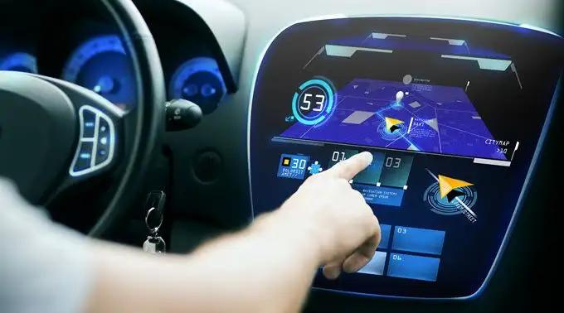
THE PROBLEM
EV market suffers as people are hesitant to buy EV due to too much technical jargons present over the dashboard.

Slide 3

THE SOLUTION
Developing a user-friendly dashboard that transforms confusing data into clear, actionable insights presented in simple language.

Slide 4

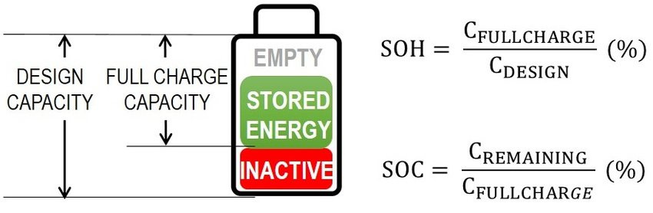
WHAT MATTERS?
SOC
SOH

Slide 5

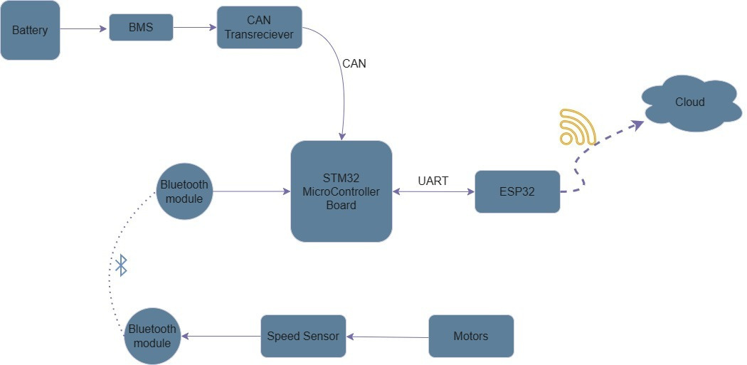
BLOCK DIAGRAM

Slide 6

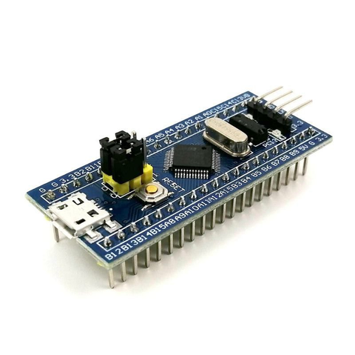
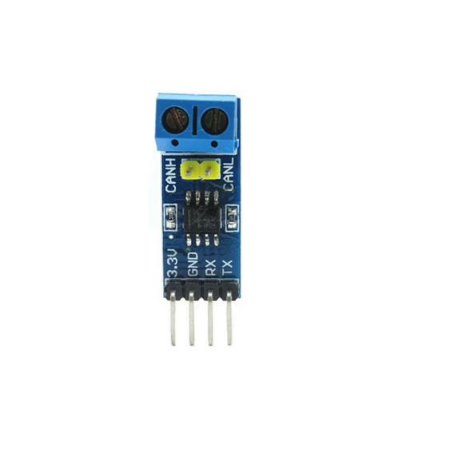
Battery to CAN
1
STM32 Bluepill
2
CAN Transreceiver

Slide 7
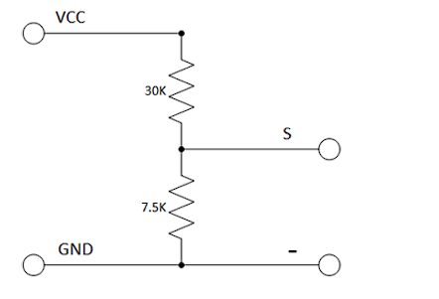
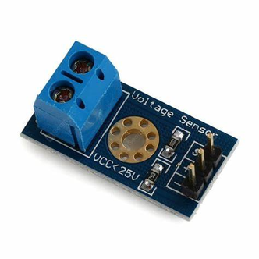
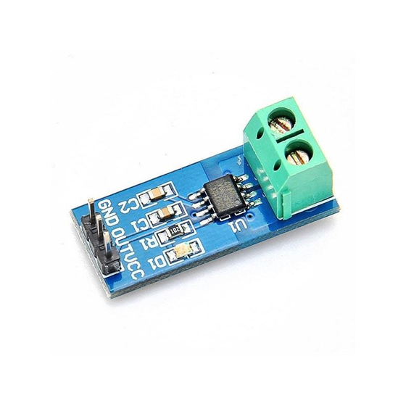
Voltage and Current Sensor
1
Voltage Sensor
2
Current Sensor

Slide 8
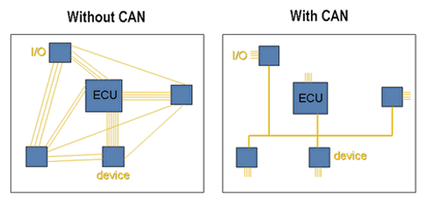
Why CAN ?

Slide 9
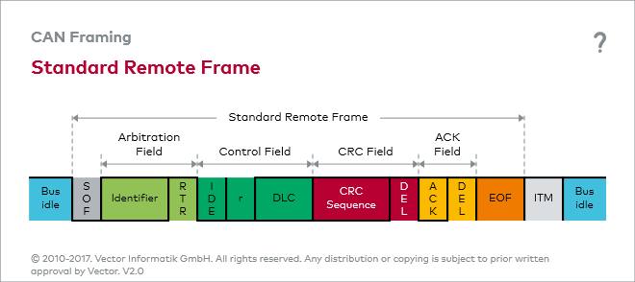
CAN Data Frame

Slide 10
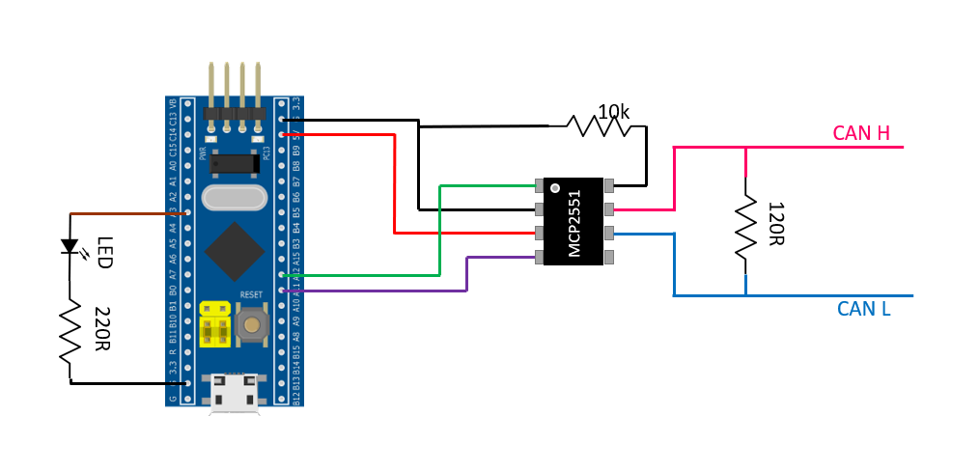
Connection

Slide 11
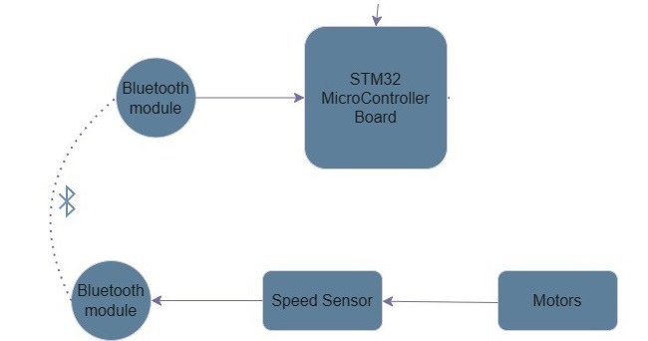
Introducing Bluetooth

Slide 12
Rotary Encoder Working

Slide 13
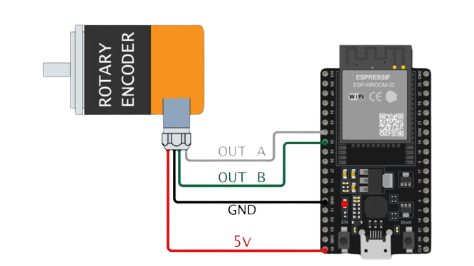
Calculating Motor Speed
ENCODER
ESP32
Red
Black
White(Channel A)
Green(Channel B)
VCC
GND
GPIO26
GPIO14

Slide 14
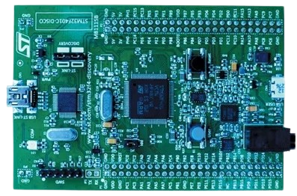
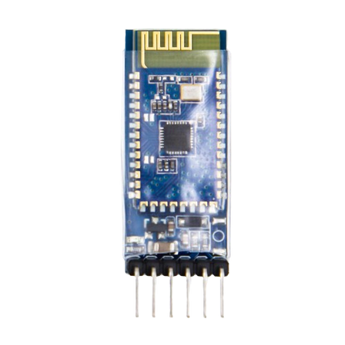
Receiver Circuit
MAIN BOARD
BLUETOOTH MODULE
PA0
PA1
5V
GND
TX
RX
VCC
GND
Bluetooth
Transreciever
Main Board

Slide 15
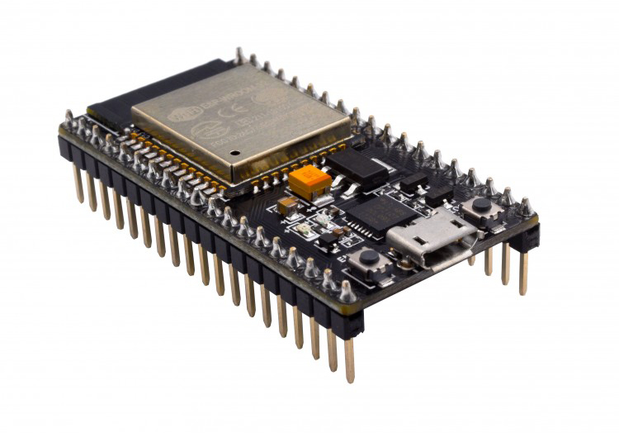
ESP32 to Cloud

Slide 16
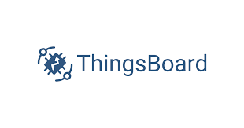
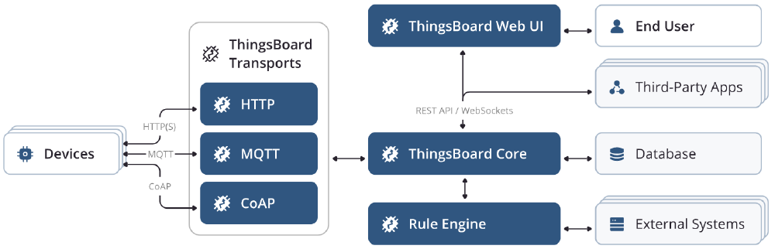

Slide 17
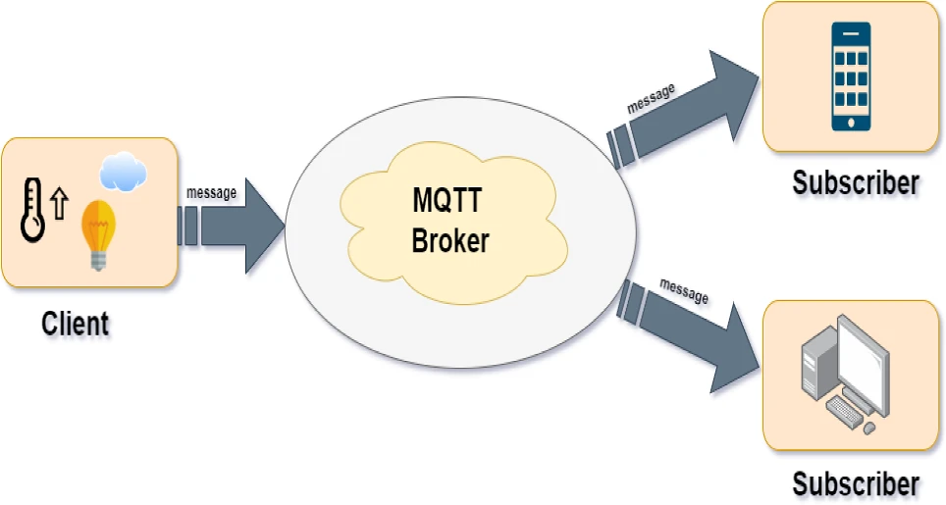

Slide 18
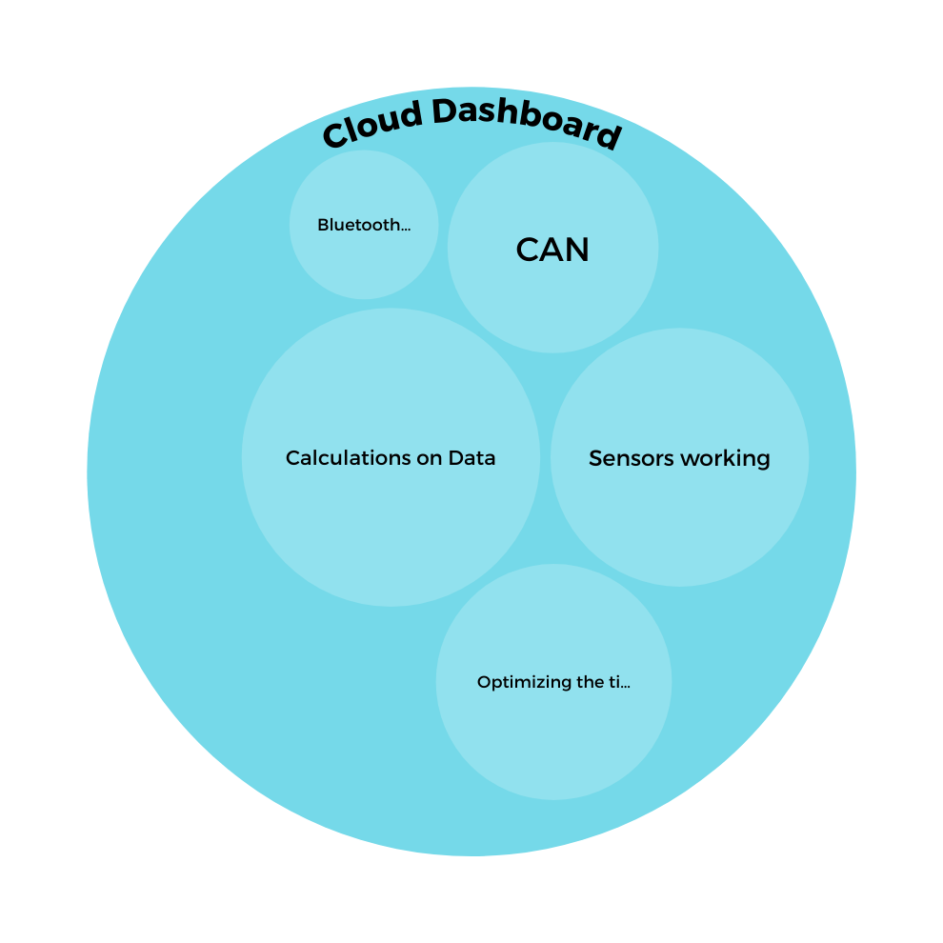
BRINGING IT ALL TOGETHER

Slide 19
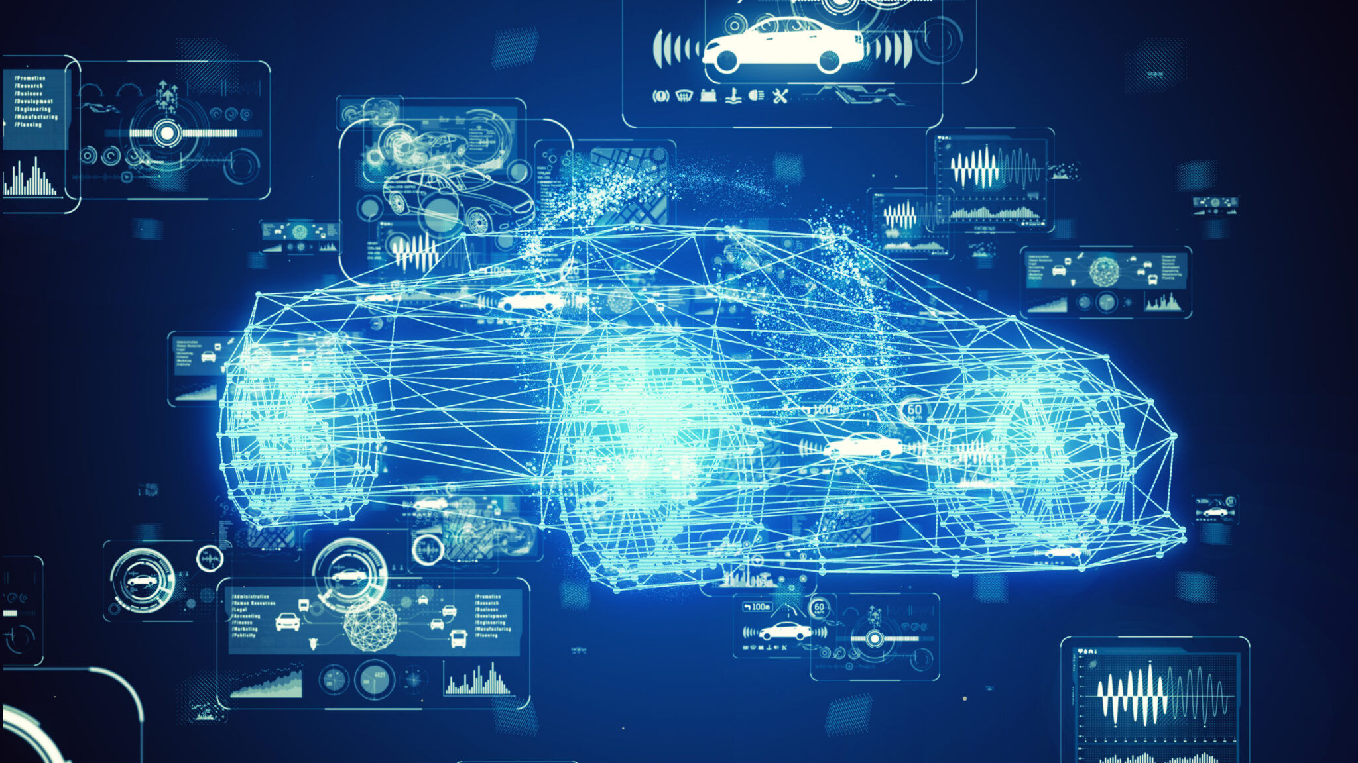
THANK YOU

